Slide 1


Mathematics in Medicine: Enhancing your health.
NZMSC 2011: ANZIAM Lecturer g.c.wake@massey.ac.nz
Graeme Wake
Centre for Mathematics in Industry
Institute of Information and Mathematical Sciences
Massey University Auckland

Slide 2
Mathematics and Statistics-in-Industry Study Group
5 – 10 February, 2012
http://www.rmit.edu.au/maths/misg
The annual Mathematics and Statistics-in-Industry Study Group (MISG) workshop brings together leading mathematicians from universities, the public and the private sector from across Australia, New Zealand and around the world to tackle complex technical problems facing Australian and New Zealand businesses and industry.
RMIT University’s School of Mathematical and Geospatial Sciences will host the annual MISG Workshop for three years from 2010 - 2012.
Industry partners are encouraged to contact the School of Mathematical and Geospatial Sciences with potential projects.

Slide 3

The 10 Commandments
Simple models do better!
Think before you compute Graeme Wake
A graph is worth 1000 equations
The best computer you’ve got is between your ears!
Charge a low fee at first, then double it next time
Being wrong is a step towards getting it right
Build a (hypothetical) model before collecting data
Do experiments where there is “gross parametric sensitivity”
Learn the biology etc.
Spend time on “decision support”
Modelling Paradigms in Contract Research

Slide 4


Slide 5

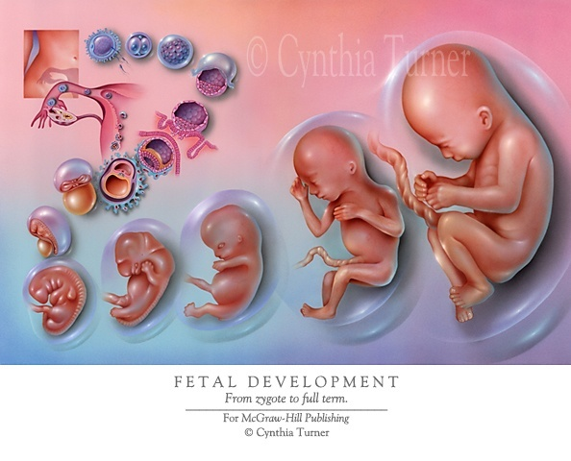
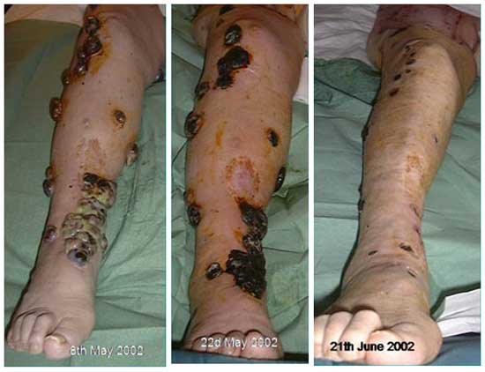
Topics:
1. Cell-growth & Cancer treatment
2. Developmental Plasticity
3. Fetal growth
4. Glucose-Insulin Models & Leptin reversal

Slide 6
1. Cell-growth & Cancer treatment
History of the cell-growth model – personal.
1988+: Horticulturists ask me to “provide an understanding
of time-series data” which showed that cell
populations, structured by size, evolved by
simultaneously growing, dividing and dying, evolved
to a
“STEADY SIZE DISTRIBUTION”
SSD - first take-out.
This data was for plant-root cells, maize etc.
This result was robust, independent of the initial condition, and in dynamical systems terms, was attracting.

Slide 7
SSDs
What is a SSD? Introduce n(x,t), the number density of a cell population cohort structured by attributes (x) like:
* size (say = DNA content) – this is us
* age
* time in a given phase….this is us also….
etc
Then
∫_{a}^{b} n(x,t) dx = # of cells (biomass) in size interval
[a,b], evolving in time.

Slide 8
SSD behaviour: n( . ,t) evolves like:

Slide 9
Core model
This led to the first cell-growth model:
n_{t} = - (gn)_{x} + bα²n(αx,t) – bn – μn(x,t), x,t >0,
α >1.Why?
growth addition through loss through death
division division
n(0,t) = 0, n(∞, t) = 0, n(x,0) given, n(x,t)≥ 0.
The terms are all local except “n(αx,t)”.
x = 0 x/α x αx
x

Slide 10
Key questions and answers
The question then is:
Are there solutions of the form
n(x,t) = N(t) y(x) = e ^{-λt} y(x) ? Q. sign of λ????
Yes there is:
1."A functional differential equation arising in modelling of cell growth". J Australian Math. Soc. Series B, Vol 30.424-435,1989 ( A J Hall and G C Wake).
2. "Functional differential equations determining steady size distributions for populations of cells growing exponentially",J.Austr.Math.Ser;B, Vol 31,434-453,1990 ( A J Hall and G C Wake).
3. "Steady size distributions for cells in one-dimensional plant tissues" Journal of Mathematical Biology. Vol 30. No 2. pp101-123. 1991 (A J Hall, G C Wake and P W Gandar).
We then added dispersion, see later…
4. “Functional differential equations for cell-growth models with dispersion” Comm. Appl. Anal. 4, 2000, pp 561-574. (G C Wake, S Cooper, HK Kim, & B van-Brunt).
We then added asymmetrical cell-splitting….
5. “Asymmetric cell division in a size-structured growth model”, Journal Differential and Integral Equations” Vol 24 (7-8) July/August 2011 pp787-799.
(Subcharoen T, van Brunt B & Wake GC.)
This turns out to be a robust outcome- we now conjecture that
“The corresponding non-local eigenvalue problem has a complete set of eigenfunctions, with one significant value the SSD of which gives the asymptotic behaviour.”
This is of huge medical significance!! Coming in 2012++++

Slide 11
New Mathematics
The SSD is y(x), which in the no-dispersive case satisfies the interesting non-local equation:
y’(x) = aα y(αx) – a y(x), x > 0,
a = bα/g, ∞
y(0) = 0, y(x) ≥ 0 , ∫₀ y(x) dx = 1.
We prove in Reference 1 that this is well-posed and find y(x)
Explicitly. How??
And the λ = μ - b(α-1) <> 0, in n(x,t) = e ^{-λt} y(x).
< Therefore this is a healthy growing cohort.
> Therefore this is a decaying cohort

Slide 12
Generic equation
This is akin to the “pantograph equation”
Raised in the first MISG in Oxford in 1970
Is generally ill-posed as an IVP:
“the future is dictating the past”
y`(x) = aα y(αx) – a y(x), x > 0, α >1,
y(0) = 0, y(∞) = 0.
For us it is an “eigenvalue problem”, and we are at the principal eigenvalue.

Slide 13
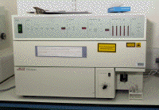
Flow Cytometry
Sample in
Laser
Beam
Moment of analysis

Slide 14
The Human Cell Cycle
1 hour
Senescence
M
G2
4 hours
11 hours
(highly variable)
G1
S
10 hours

Slide 15
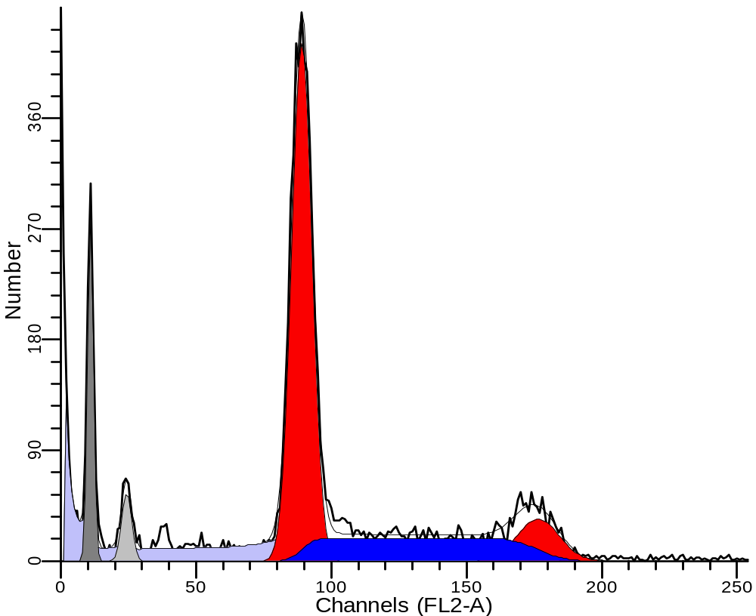
Steady DNA Distribution (SDD)
G1 Phase
G2/M Phase
S Phase

Slide 16
Idea
G₁/G₀
division
Cell Count
S
G2/M
x (DNA)

Slide 17
4. Further new maths
Finite Differences+convolution: Do get SSD’s but slow.
Look for separable solutions…..
If solutions are attracting then
the y’s are the SSDs in each phase.
In all cases N(t) ~ exp (-λt)

Slide 18
Model of a cell line unperturbed by cancer therapy G1-phase

Slide 19
Dispersion
There is white noise particularly in the S-phase
Growth dx = g dt + σ dX
Deterministic White
Growth Noise
Gives Fokker-Planck Equation
S_{t} = (D S)_{xx} - (g S)_{x} +… etc.,
D = σ ²/2.

Slide 20
S-phase equations
G1
division
Cell Count
S
G2/M
x (DNA)

Slide 21
Equations for y₁ the SSD: G1-phase
Delay equation equation:
Solution: y₁(x) = δ(x-1), Λ = ½. Check. Exam Question on generalised functions?
Fredholm integral equation (non-symmetric):

Slide 22
Medical options
Cure by
* poison = chemotherapy
* burn = radiotherapy
* cut = surgery

Slide 23
Taxol effect: 6 weeks “in vivo”

Slide 24
Model of a cell line perturbed by paclitaxol cont…

Slide 25
Parameter Fitting
Minimise
Choose a parameter set
Find the model of an unperturbed cell line SDD
Use finite differences and convolution to solve the model of a cell line perturbed by taxol
Calulate the objective function value

Slide 26
NZM13 DNA profile 0 hours after the addition of Taxol
800
Model
700
Data
600
500
Doubling Time:
Model: 72 hours
Data: 76 hours
Cell Count
400
300
200
100
0
0
0.5
1
1.5
2
2.5
3
3.5
x (Relative DNA Content)

Slide 27
NZM13 DNA profile 18 hours after the addition of Taxol
600
Model
Data
500
400
Cell Count
300
200
100
0
0
0.5
1
1.5
2
2.5
3
3.5
x (Relative DNA Content)

Slide 28
NZM13 DNA profile 48 hours after the addition of Taxol
350
Model
300
Data
250
200
Cell Count
150
100
50
0
0
0.5
1
1.5
2
2.5
3
3.5
x (Relative DNA Content)

Slide 29
NZM13 DNA profile 72 hours after the addition of Taxol
250
Model
Data
200
150
Cell Count
100
50
0
0
0.5
1
1.5
2
2.5
3
3.5
x (Relative DNA Content)

Slide 30
NZM13 DNA profile 96 hours after the addition of Taxol
200
Model
Data
150
Cell Count
100
50
0
0
0.5
1
1.5
2
2.5
3
3.5
x (Relative DNA Content)

Slide 31
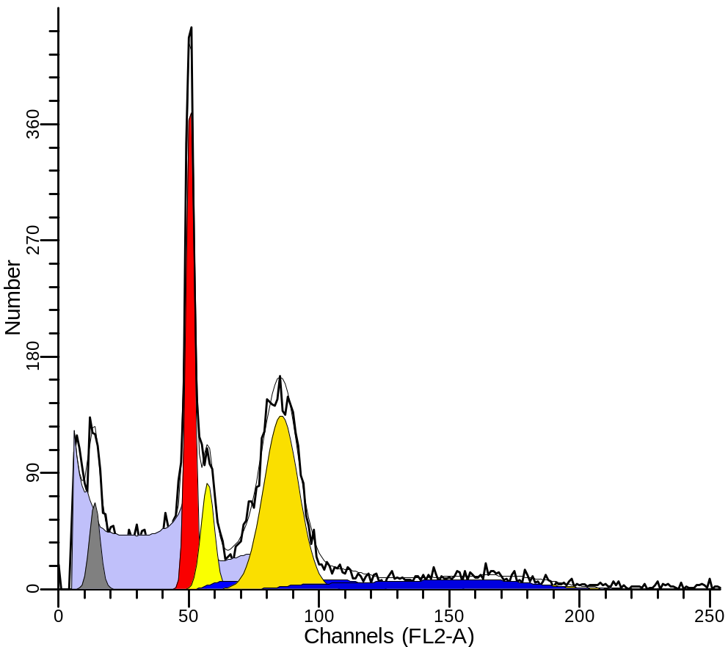
Typical Clinical Sample
Patient with metastatic malignant melanoma
normal cells
cancer cells

Slide 32
Summary…
We have a generic set of simple (?)models for cellgrowth/division
It can be, and is being used to underpin decision support
There is plenty of “new mathematics” here
☺ ☺ ☺

Slide 33

2. Developmental Plasticity

Slide 34
Outline.
Outline
1. Introduction to the biology
2. Nishimura’s deterministic model
3. A stochastic model of Plasticity
4 Results
5. Discussion of the stochastic model

Slide 35
2.1. Introduction
An organism may express different phenotypes (gene expression) in response to changes in the environment. This phenomenon is called plasticity and appears to be an important mechanism enhancing an organism’s ability to survive and reproduce.
That is, plasticity induces a fitness advantage for the organism.

Slide 36
If the predation rate increases it destroys the population fitness;
Changes in the characteristics are
initiated with consequential changes
in the Energy content.

Slide 37
In epidemiology, a popular theory is that the rising incidences of coronary heart disease and Type II diabetes in human populations undergoing industrialization is due to a mismatch between a metabolic phenotype determined in development and the nutritional environment during development, to which an individual is subsequently exposed. This is known as the
'Thrifty phenotype' hypothesis.

Slide 38
2.2. Nishimura’s deterministic model
Assume a prior specific death rate of μ₁
for the “prey” and, when the environment changes, it has a death rate of μ₂ (with
μ₁ >μ₂) and that the development of the plastic response incurs an energy cost from a base of c₁ to c₂ (with c₁ < c₂).

Slide 39
A fitness function W(t) for the suitable fitness currency as a function of time t at which the plasticity is expressed - linking the predation rate to the energy cost of the plastic response:
(1)
The first term = the survival probability in the predator environment;
The second term = the amount of remaining energy;
where T = total time, t = the switching time,
E = total energy budget, W = “plasticity”,
c_{i} = the Energy consumption rate in the respective modes i= 1, 2.

Slide 40
c₁ is the default baseline energy cost to the prey individual per time, and
c₂ includes the additional costs of building and maintaining the defensive phenotype per unit time, c₁ > c_{o.}
This is a simple counting exercise.
Now differentiate w.r.t t …….

Slide 41
Nishimura uses equation (1) to find the maximum fitness response for the time at which plasticity is expressed following the change in the environmental conditions which most advantages predation. This is found to be trivially, W’(t) = 0, at which time the plasticity is (actually) maximised, which gives:
(2)
But this assumes a deterministic approach in the cohort where there is no variability,
So……. Introduce variability…

Slide 42
2.3. A Stochastic Model of Plasticity
Suppose that the fitness of the organism at time t given by equation (1) is now a stochastic variable. In terms of pressure for the development of plasticity it is the expected value of the fitness that is of interest. That is, the time of plastic response t that maximises the expected value of the fitness is of interest in determining the evolutionary path.

Slide 43
Let α = μ₁ - μ₂ > 0
A = E – c₂T
c = c₂ – c₁ > 0
Then
(2)
Let the time of the plastic response be a normally distributed random variable with mean and variance . Note this is not assuming W is Gaussian, only its components.
Q. Should this be a Beta distribution????

Slide 44
Let the time at which the defensive phenotype is
developed be a probability distributed random variable
with M_{t} as the moment generating function of the
random variable t, which is also the Laplace transform of t.
The choice we made earlier of normality is of course
debatable. However, provided the infeasible region
(negative time) is sufficiently small, it provides an easy and
realistic framework.
Also it has the advantage that when we set the variance of t
to zero, it then recovers the deterministic case described
by Nishimura (2006).

Slide 45
Then the expected value of the fitness of the organism is:

Slide 46
Noting that

Slide 47
Then we get
(4)
Note that equation (4) is similar to the deterministic case expressed by equation (1) with t → - 2α :

Slide 48
Equation (4) has 2 variables associated with the plasticity, the time of the response in relation to the environmental stimulus and the variance of this response in the population of interest . Finding the maximum fitness by differentiating with respect to each of these variables and setting to zero gives the two inconsistent equations:
(5)

Slide 49
The fitness of the organism is maximised when plasticity acts at the time from the environmental stimulus given by:
(6)
This uses the first equation ∂/∂ = 0.

Slide 50
This shows that when the time of plasticity is stochastic then the mean time of plasticity optimising the expected value of the fitness is extended by an amount given by . In this respect variation in the response of plasticity in the population might be seen as an advantage in terms of providing extra time for the average response in the population to be most effective.

Slide 51
However, in terms of Life History analysis the variance of the response to plasticity might be regarded as the variable of interest. That is, an organism might seek to optimise fitness by manipulating the variance of the response, perhaps by collecting a variety of alleles or by developing epigenetic modes to express such variation. In this case the optimum variance of plasticity to maximise the fitness is given by:

Slide 52
2.4 Results
However, the results show that the maximum expected value of fitness is not given by an unique pair of numbers for the average time of plasticity and the variance of plasticity, but rather by a set of numbers lying on a straight line in the plane of the average time and the variance of plasticity. Repeating this here…..New term
This is shown on the following diagram:

Slide 53
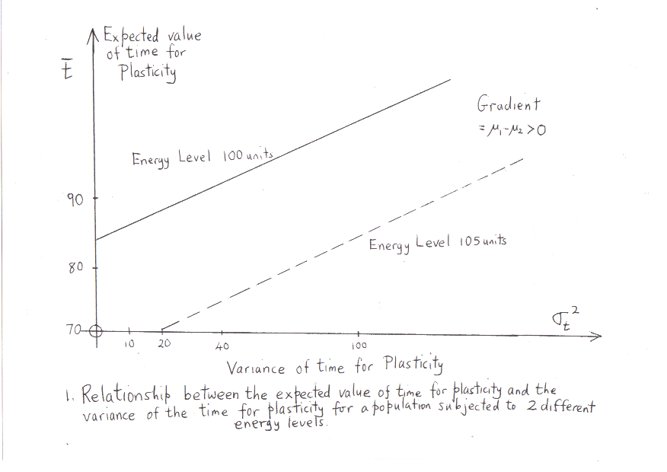

Slide 54
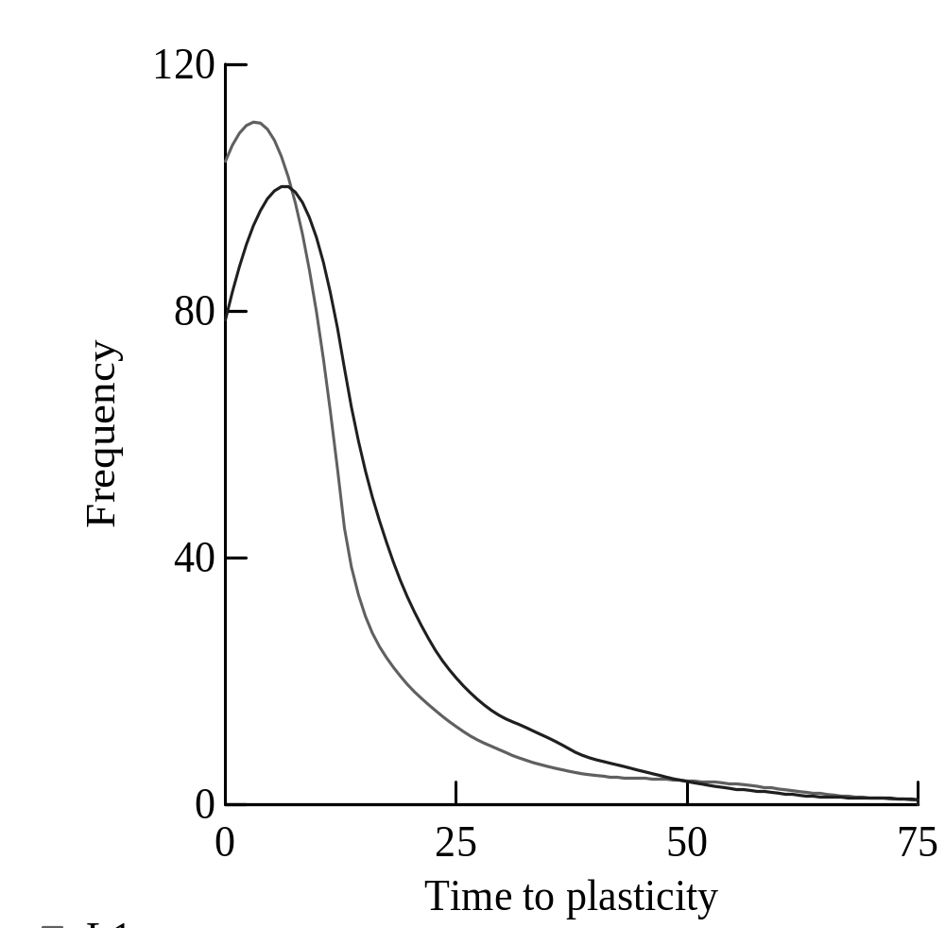
Figure 2: The frequency distributions for the time to plasticity for 2 populations each having the same optimal expected value for fitness given by equation (3).

Slide 55
A population might not be on the optimal mean time – variance of plasticity line for a number of reasons. For example, the average energy available E might change, resulting in a parallel shift of the optimum mean time variance line, or the predation rates might change altering the slope.

Slide 56
If the population ends up off the optimal line the question arises of the expected path in the mean time of plasticity – variance of plasticity space that it will take to get to the new optimal line.
To calculate this path we assume that the probability distribution of time t to switch states (the plasticity factor for the population) remains Gaussian. This means that the new environment induces a similar average change in t across the population, preserving the Gaussian character of its probability density.

Slide 57
Transition to a new optimal state:
Assuming that the path of the population in mean time of plasticity – variance of plasticity space proceeds in a direction most favourable to the population this means
that the path from a point
to a point on the new optimal line .
That is, the population will follow a path that is perpendicular to the level curves of the expected value of the fitness function (3).

Slide 58
Let x = variance,
y = mean time
w₁ = maximum of the expected value of
fitness, with
available energy is E₁; w₁ = F(x,y)
Then E₁ → E₂
The path to w₂ = maximum of the expected value
of fitness, with
available energy E₂ will follow the o.d.e
dy = ∂F/ ∂y
dx ∂F/ ∂x
which is perpendicular to the level curves, that is the steepest path. This is shown in the following diagram…it is obtainable analytically!!!!

Slide 59
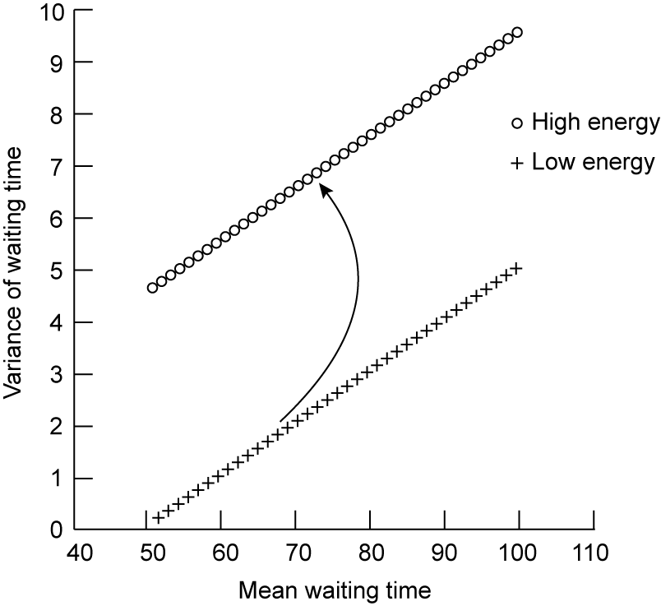
Figure 3. The trade – off between the expected value of the time for plasticity and the variance of the time for plasticity in a population subjected to 2 different energy availabilities, and the optimal path of time to plasticity mean and variance when the energy available changes from low to high.

Slide 60
Example
Consider a population with
T = 100 days,
an average energy level of 100 units,
μ₁ = 0.2, μ₂ = 0.1 days⁻¹
c₁ = 0.5, c₂ = 2 units. days⁻¹
standard deviation σ = 8 days.
This will have an optimal average time to optimal plasticity of 84.1 days. (The deterministic calculation is 77.7 days, that is, 6.4 days less).
If the energy level available from the environment changes to 105 units then the equations imply the population will move to an optimal mean time for plasticity of 81.8 days with a standard deviation of 7.2 days.

Slide 61
Example continued
The extra energy available results in a shorter time to implement plasticity, because the population has more energy to spare on maintaining plasticity for a longer time.
Energy Mean time Std Deviation
100 84.1 days 8 days
105 81.8 days 7.2 days
Outcomes in Red

Slide 62
2.5. Discussion
The analysis presented here shows a relationship between the average time for plasticity and the variance of the time for plasticity.
The higher the variance the longer the average time for plasticity that maximises the organism’s fitness.
If there was a constraint which acted to ensure that plasticity required some minimum time, the organism might adjust the variance of the time for plasticity to maximise fitness.

Slide 63
The smaller the difference between the death rates the greater the variance which ensures maximum fitness (for a given average time for plasticity).
Alternatively, the greater the difference between death rates the smaller the variance for maximum fitness.
Similarly for the energy cost of implementing plasticity.
The moments (1st and 2nd) of the optimal distribution are obtained by a shift in available energy easily by solving a first order o.d.e.

Slide 64



3. “OPTIMAL NUTRITIONAL STRATEGIES FOR MAMMALIAN DEVELOPMENT:
A SYSTEM APPROACH”
NZMSC 2011
Graeme Wake
Centre for Mathematics-in-Industry,
Massey University, Auckland, New Zealand
&
Chanakarn Kiataramkul (Bangkok)*
Alona Ben-Tal (Massey University)
Yongwimon Lenbury (Bangkok)
Notes:
In this study, we want to find the daily nutrient intake, considered as a control, for the mother during the second half of the pregnancy to achieve the desirable birth weight. We set the value of the optimal birth weight because if the birth weight is greater than the optimal value, it will cause injury to both mother and fetus. Conversely, if the birth weight is less than that value, the mortality and morbidity rate of the newborn will increase.
This problem is formulated, first by considering a growth model of a fetus in animals such as sheep. Then, by using the nutritional intake as a control, which appears in a nonlinear fashion, namely in the Michaelis-Menten form, we can obtain a coupled equation for the food intake with the fetal rate equation. This gives a two-dimensional dynamical system which is a two-point boundary value problem.
In the special case, if f and u is separable and g is a function of u , then u_dot =0. And therefore u is a constant, determined by the end condition in x.

Slide 65
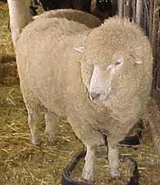
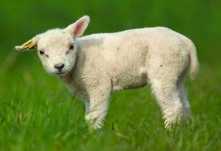
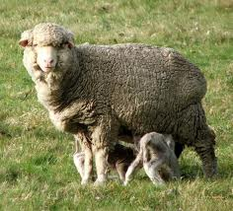
OPTIMAL NUTRITIONAL STRATEGIES FOR MAMMALIAN DEVELOPMENT:
A SYSTEM APPROACH
----------------------------------------------------------------------------------------------------
1

Slide 66


Slide 67


Developmental Programming
Birth weight is a “marker”for fetal coping mechanisms
Low birth weight or being born small might indicate a suboptimal environment.
Notes:
As this area of research expanded and developed we realised that reduced fetal growth or a low birth weight was not the cause of this increased risk in later life disease but just a surrogate or marker for the effects that the fetus witnessed whist still inside it’s mother’s uterus
Essentially just one aspect of the fetal coping system to perhaps A suboptimal environment during pregnancy.

Slide 68
“
THE GHOSTS IN YOUR GENES”
The human genomes carries more
than just genes: it also
remembers the environment and
experiences from before you were
born – which are of course,
the ghosts of your ancestors. A BBC documentary
This is the emerging field of epigenetics.

Slide 69
Recall: Our objective functional minimizes the whole nutrient intake for the second half of the pregnancy with respect to a system of ordinary differential equations modeling a fetal growth model.
= Total nutrient intake
Subject to
= Growth function
(pre-set)
where x = fetal weight in Kg
u = daily nutrient intake in
3

Slide 70
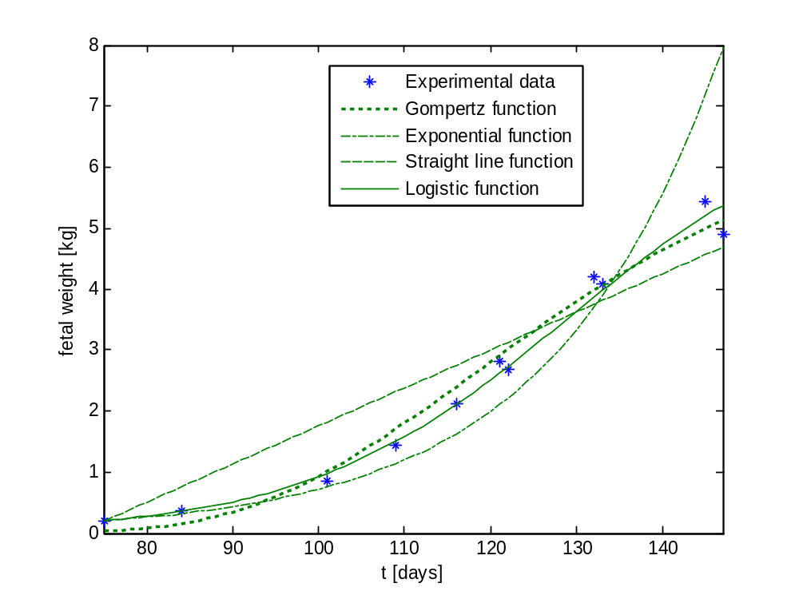
Fitting parameters to the experimental data
(data courtesy of Dr. Deborah Sloboda of NRCGD)
Logistic equation
with
The coefficient of variation, , for Logistic equation
4
Very close to 1 fits very well

Slide 71
Logistic growth with Michaelis-Menten kinetics for nutrient input
  Firstly, we consider the carrying capacity (K) as a constant.
K is a constant
This implies the optimal nutrient intake u is a constant.

Slide 72
Logistic growth with Michaelis-Menten kinetic
Secondly, after modifying the model to make it more realistic, the carrying capacity (K) is represented as a prescribed function of the cumulative intake using empirical relationships suggested by data analysis.
K is a function of
a cumulative intake
where
and is a discount factor.

Slide 73
Our problem then becomes:
= Total nutrient intake
Subject to

Slide 74
One-dimensional Optimal Control Problem
Minimize
subject to
with the boundary conditions:

Slide 75
Optimal Control Problem (cont.)
The Pontryagin’s Maximum Principle (Pontryagin et al., 1962) gives a Hamiltonian Expression:
The necessary conditions:
1.
at
(optimality condition)
2.
(adjoint equation)

Slide 76
Optimal Control Problem (cont.)
The dynamical system :
with the boundary conditions:

Slide 77
Using optimal control arguments, we can reduce the problem to a 4-dimensional dynamical system as follow:
with unusual boundary conditions:

Slide 78
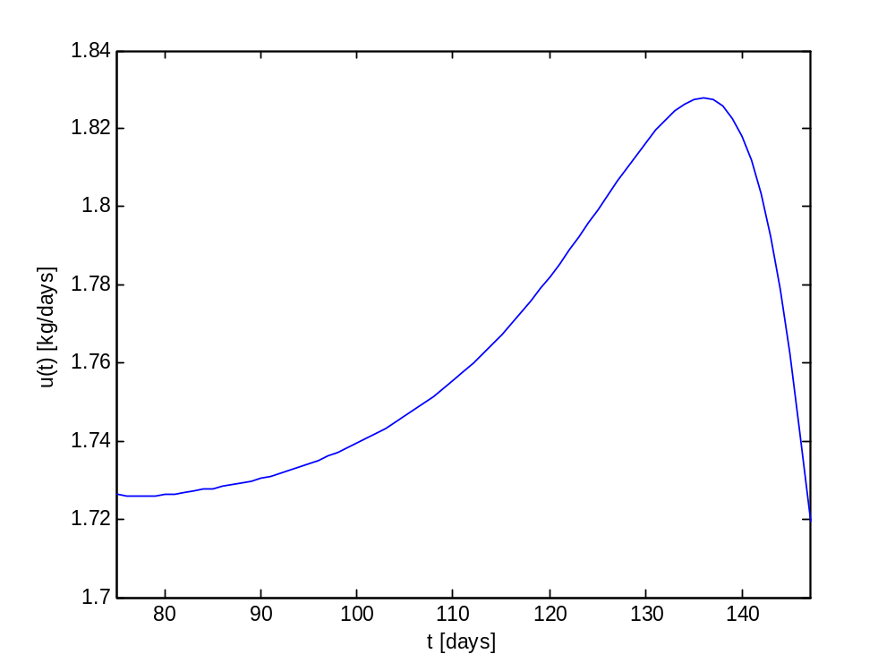
Calculated optimal nutrient intake
.
Total nutrient intake = 127.0979 kg.
The food intake is increasing in the first and middle third of the second half of pregnancy and largest in the last third of the second half of pregnancy.

Slide 79
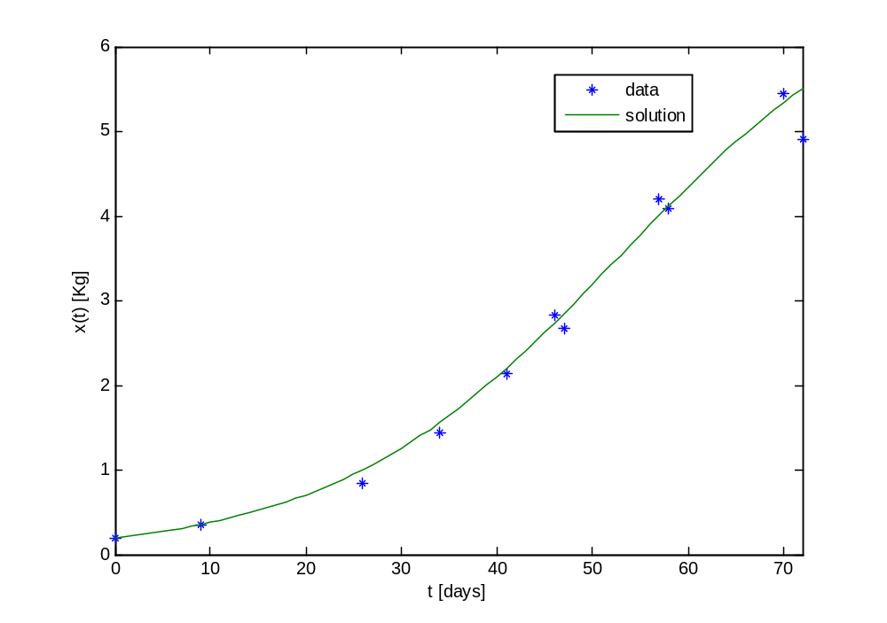
Comparing the calculated fetal weight with the experimental data
The coefficient of variation,
cf 0.9832 before
Very close to 1 fits very well

Slide 80
Illustrative parameters dependence
(Days⁻¹) | Total nutrient intake (Kg)
0 | 119.4799
0.02 | 120.7390
0.04 | 122.1535
0.06 | 123.5593
0.08 | 124.8650
0.12 | 127.0979
0.3 | 133.0866
0.5 | 136.3751
0.7 | 138.3051
0.9 | 139.5793
1 | 140.0668
Strong influence of the past
is a discount factor which indicates how the cumulative intake influence of the past.
Less influence of the past

Slide 81
Reference
Kiataramakul C, Wake GC, Ben-Tal A & Lenbury,Y. “Optimal Nutritional Intake for Fetal Growth” Mathematical Biosciences and Engineering, Vol 8(2), 2011 pp 723-732.

Slide 82
4. Glucose-insulin models
The application of a model of glucose and insulin dynamics to explain an observed effect of leptin administration in reversal of developmental programming
Wake GC, Pleasants AB, Vickers MH, Sheppard AM, Gluckman PD. Mathematical Biosciences 229 (2011) 109–114.

Slide 83
Leptin (Greek leptos meaning thin) is a protein hormone that plays a key role in regulating energy intake and energy expenditure, including appetite and metabolism. It is one of the most important adipose derived hormones. The Ob(Lep) gene (Ob for obese, Lep for leptin) is located on chromosome 7 in humans. ^{Its} administration is known to affect development.
Background Biology

Slide 84
To date, only leptin and insulin are known to act as an adiposity signal. In general,
Leptin circulates at levels proportional to body fat.
It enters the central nervous system (CNS) in proportion to its plasma concentration.
Its receptors are found in brain neurons involved in regulating energy intake and expenditure.
It controls food intake and energy expenditure by acting on receptors in the mediobasal hypothalamus[

Slide 85
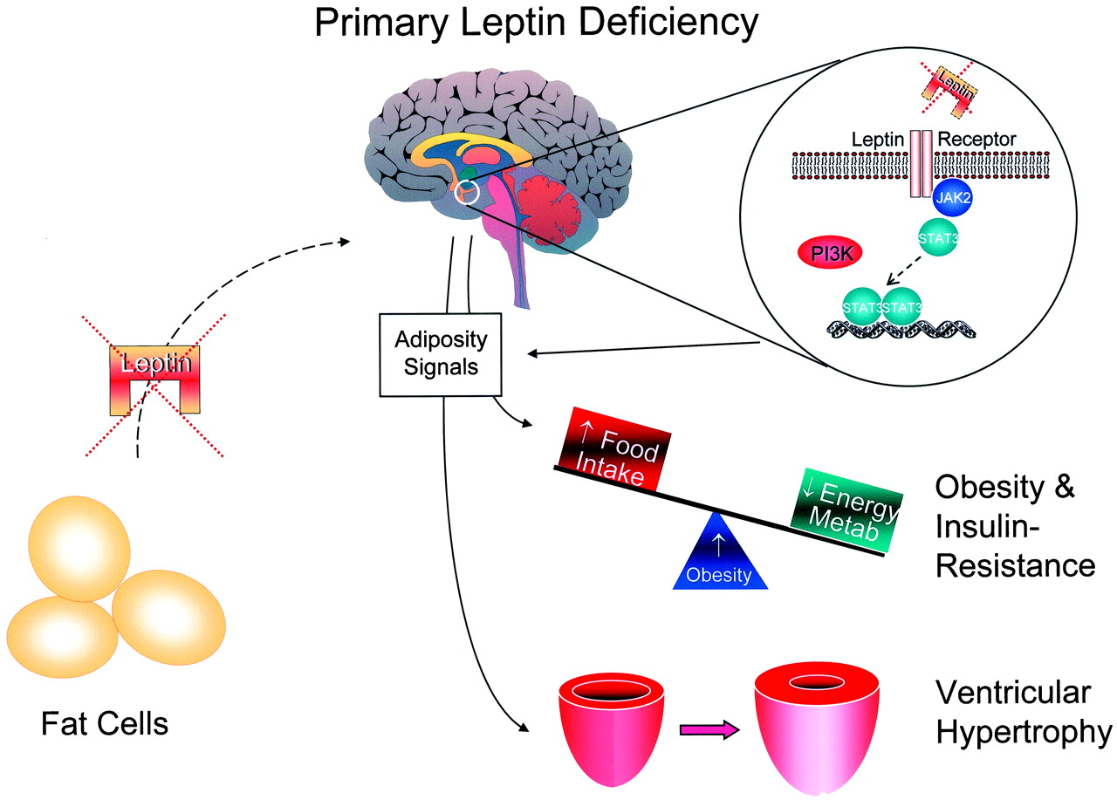

Circles of feedback in primary leptin deficiency.
Figure 1. Circles of feedback in primary leptin deficiency. This is the situation found in ob/ob mice, or rare human genetic mutations. In this setting, the adipose tissue will not be able to elaborate leptin commensurate with the fat tissue mass. This leaves the leptin receptor unoccupied. The receptor signals through janus kinase (JAK)/signal transducers and activators of transcription (STAT) pathways, with cross talk from PI3 kinase (P13K) pathways. The receptor nonoccupancy leads to a number of adiposity signals, including increased food intake and decreased energy expenditure. This also leads to ventricular hypertrophy, which is correctable with leptin infusion. Metab indicates metabolism.
Notes:
Figure 1. Circles of feedback in primary leptin deficiency. This is the situation found in ob/ob mice, or rare human genetic mutations. In this setting, the adipose tissue will not be able to elaborate leptin commensurate with the fat tissue mass. This leaves the leptin receptor unoccupied. The receptor signals through janus kinase (JAK)/signal transducers and activators of transcription (STAT) pathways, with cross talk from PI3 kinase (P13K) pathways. The receptor nonoccupancy leads to a number of adiposity signals, including increased food intake and decreased energy expenditure. This also leads to ventricular hypertrophy, which is correctable with leptin infusion. Metab indicates metabolism.

Slide 86
A quantitative understanding of the processes involved, which was lacking, will be useful in determining the treatment of obesity and other conditions resulting from prolonged energy imbalance.

Slide 87
The accepted model consists of 3 coupled differential equations
linking the glucose pool (G mg dl⁻¹), the insulin pool (I μU ml⁻¹)
and β-cell pool (β mg) which is secreted from the pancreas:
That is, for short times of the sort considered in this paper
the first two equations of the system are sufficient to describe
the system changes.
Glucose
Insulin
Beta cells:
Slow, so β
Constant

Slide 88
That is, for short times of the sort considered in this paper the first two equations of the system (1) are sufficient to describe the system changes.

Slide 89
The equilibrium levels
The nullcline of the first (glucose) equation is given by , and similarly the nullcline of the second (insulin) equation is . The equilibrium (steady state) point (G_{E}. I_{E}) of the glucose and insulin system will be at the intersection of these nullclines as illustrated….

Slide 90
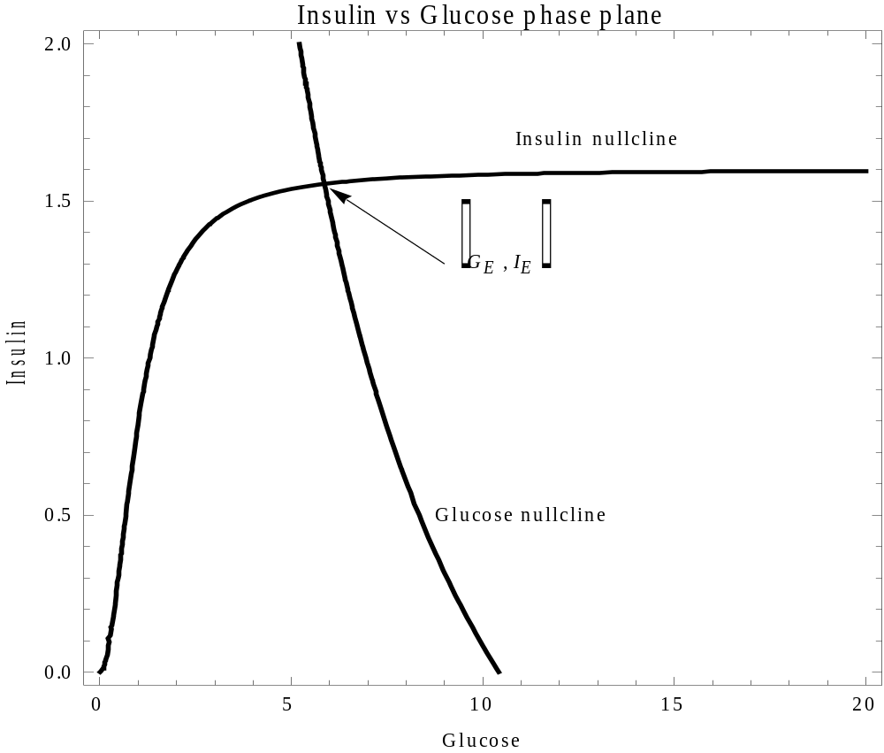

Slide 91
The equilibrium glucose satisfies
Changes w.r.t s and R_{o}

Slide 92
We note that these quantities are of opposite sign. To consider the change in G_{E} (and hence I_{E}) due to arbitrary and independent perturbations ∆s in s and ∆R_{o} in R_{o}, we consider the directional differential, given by:
(The sign will change)

Slide 93
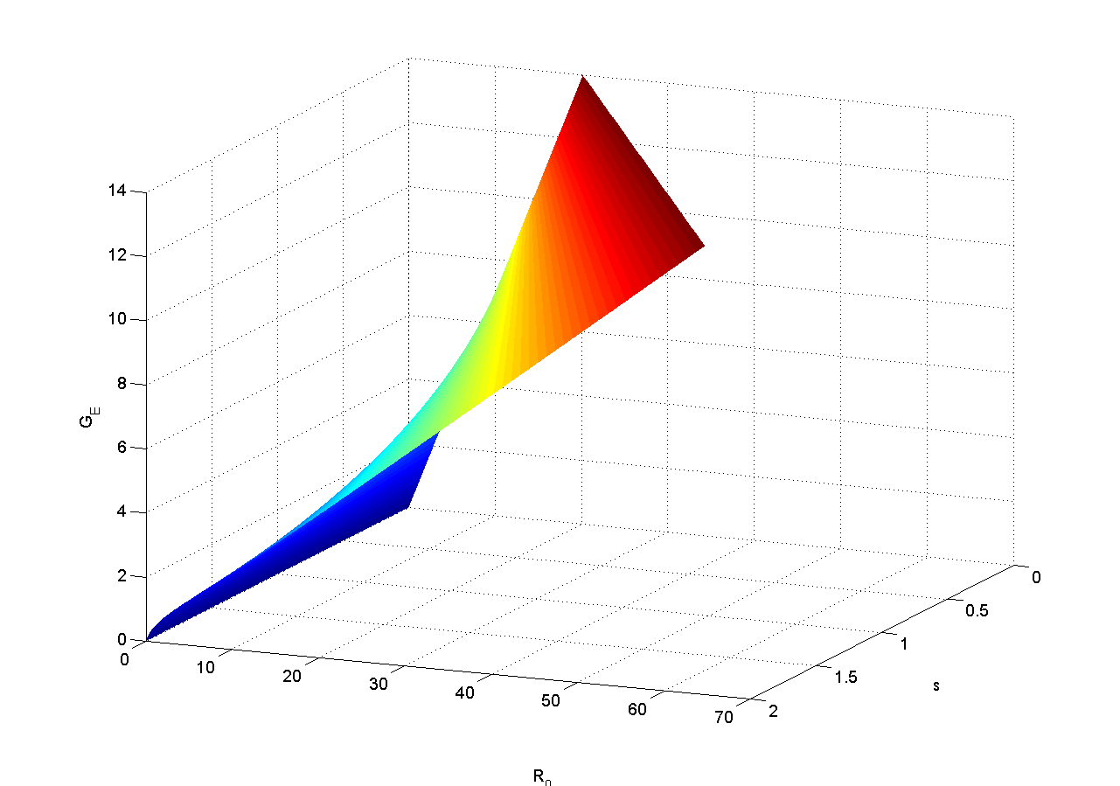
Glucose Equilibrium surface

Slide 94
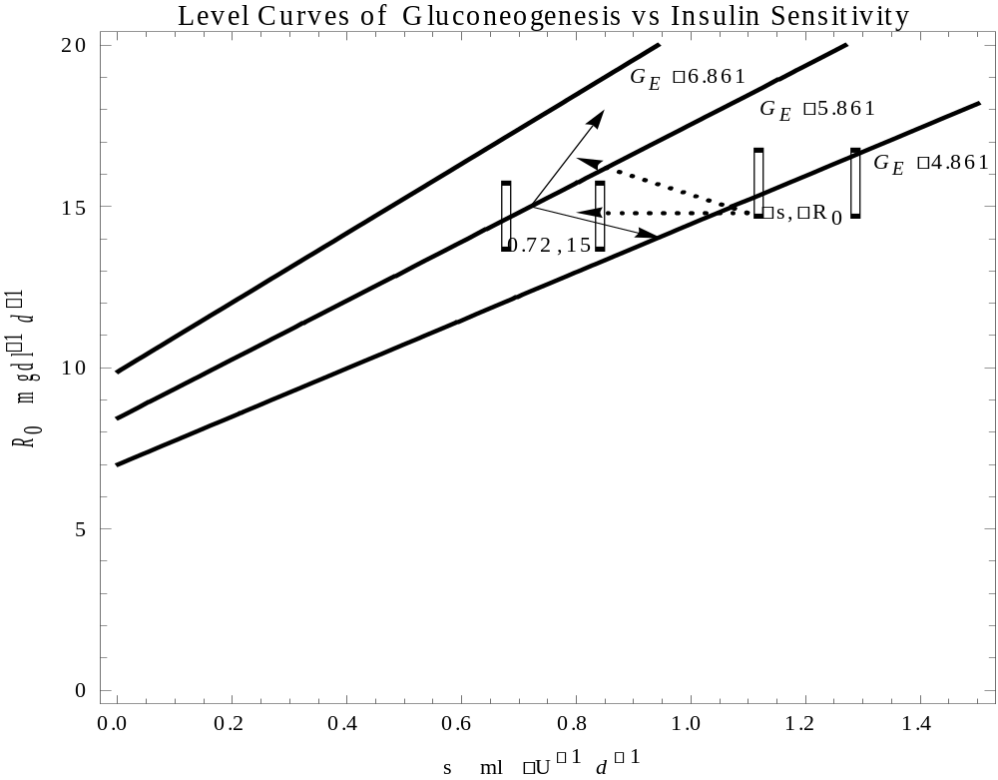

Slide 95
If the equilibrium glucose value G_{E} is greater
than the G* obtained from finding the roots of the cubic equation
then as the insulin sensitivity s increases or the
gluconeogenesis R_{o} decreases, the glucose and insulin
equilibrium values decrease in this particular direction.
(See the signs of the expressions in equation.)
On the other hand if the equilibrium glucose value G_{E} is less
than the G* obtained from solving the cubic equation then
as the insulin sensitivity increases or the gluconeogenesis
decreases the glucose and insulin equilibrium values increase in
this particular direction..

Slide 96
This is the proposed physiological mechanism of what we call “leptin reversal” which may proceed in two ways.
As a second manifestation of “leptin reversal” if we consider the rate of change of G_{E} with s and R_{o} from a given level curve G_{E} = constant, say 5.861, we can use equation (6) as defining the direction in which this switch occurs.

Slide 97
Conclusions
This has enormous potential for quantitative
underpinning of the early intervention to
enhance a better quality of life.
It is being expanded to include a fat pool and
then will be valuable to underpin diet
decisions.
Prototype model of glucose(G) / insulin(I) / leptin(L) / fat mass(M) dynamics:

Slide 98
Advertisement: 5th December 2011
Masters thesis award.
To enrol in February 2012 or later.
$20, 000 p.a. including fees.
Someone with a mathematics first class honours degree would be ideal.
Outline. Insulin-like growth factor (IGF-I) plays a crucial role in growth and development, although the physiology is complex. The objective of the project is to develop a mathematical model of the dynamic interactions between insulin-like growth factor (IGF), IGF receptors and plasma IGF binding proteins. The goal is to use this model to help understand seemingly paradoxical measurements of these interactions. The Masters candidate would require an honours degree in mathematics, preferably with a background in dynamical systems, and be willing to work with biologists from the Liggins Institute. Funding for the Masters project (stipend + fees) could be covered by the National Research Centre of Growth and Development.
Contact Graeme Wake g.c.wake@massey.ac.nz
or Paul Shorten paul.shorten@agresearch.co.nz

Slide 99
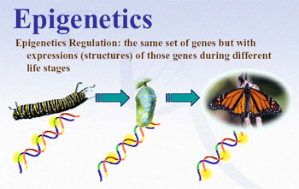

Questions and Comments

